Slide 1
New Evidence and Perspectives on Mergers
Gregor Andrade
Mark Mitchell
Erik Stafford
Journal of Economic Perspectives
Spring 2001
Presented by: Yan Li

Slide 2
Research Question:
why do mergers occur?

Slide 3
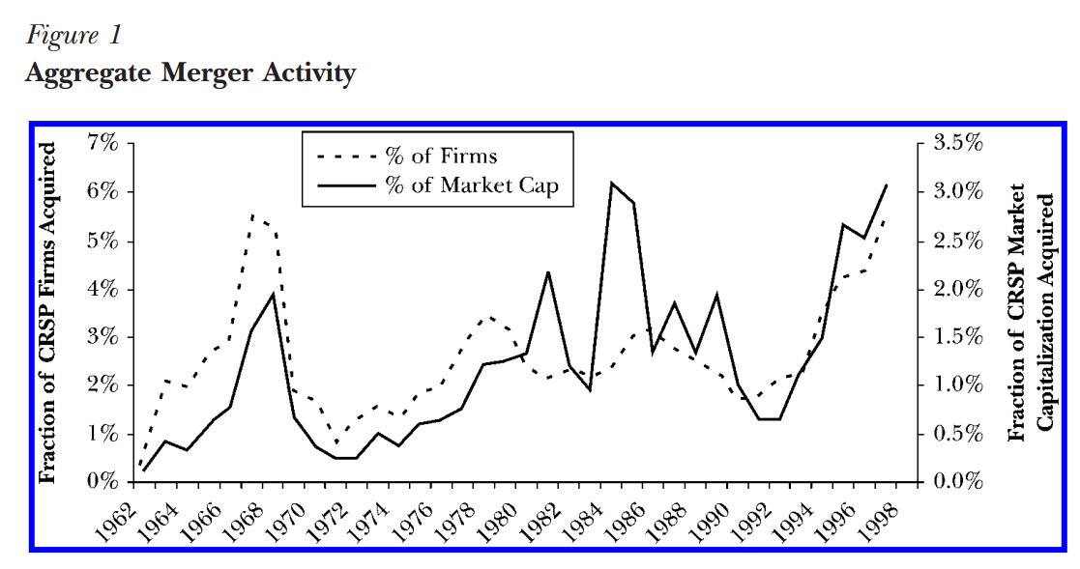
Mergers in the 1990s: What’s New?
Notes:
There are three major waves of takeover activity since the early 1960s: the 1960s wave contained many more deals; On a value-weighted basis, the 1980s were truly a period of massive asset reallocation via merger; the merger and acquisition activity in the 1990s seems to be even more dramatic and widespread, with number of deals comparable to the 1960s, and values similar to the 1980s.

Slide 4
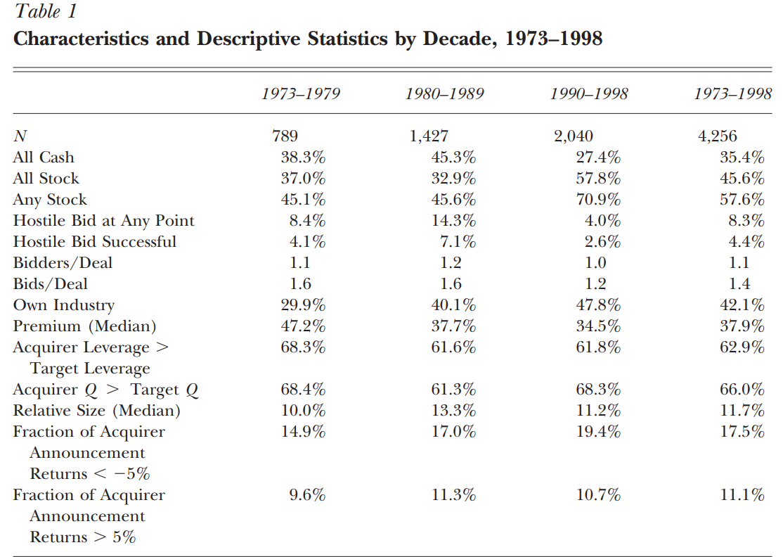
Mergers in the 1990s: What’s New?
Notes:
The first key distinction is the overwhelming use of stock as a method of payment during the latter decade. About 70 percent of all deals in the 1990s involved stock compensation, with 58 percent entirely stock financed. These numbers are approximately 50 percent more than in the 1980s.
The second distinction is the disappearance of hostility in the takeover market
Consistent with the more friendly atmosphere, the average transaction in the 1990s involved only one bidder, and 1.2 rounds of bidding, far less than during the 1980s.
The third distinction is the trend that both parties are in the same industry

Slide 5
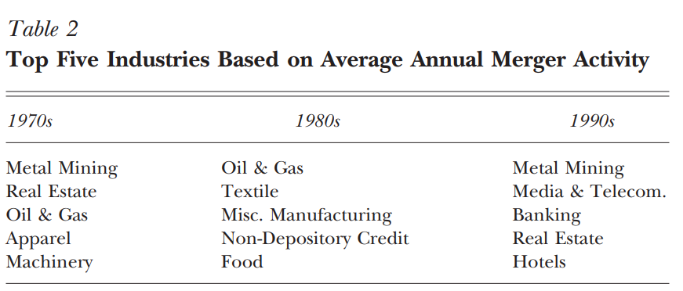
Mergers in the 1990s: What’s New?
Notes:
There is no overlap between the top five industries, ranked by merger values, of the 1980s and 1990s
If rank industries in each decade by the market values of all acquired firms, and then correlate these ranking across decades, the authors find that the correlations are negligible - that is, industries that exhibit high levels of merger activity in one decade, are no more likely to do so in other decades.

Slide 6
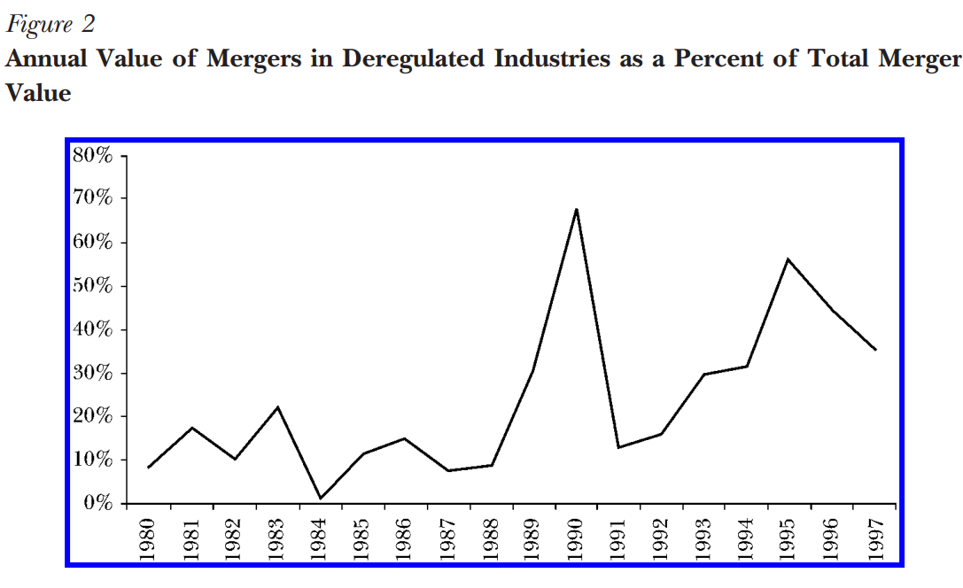
Mergers in the 1990s: What’s New?
Notes:
Industries having undergone substantial deregulation since 1973: airlines (1978), broadcasting (1984 and 1996), entertainment (1984), natural gas (1978), trucking (1980), banks and thrifts (1994), utilities (1992) and telecommunications (1996).
The authors define a ten-year period around each of these events (three years before to six years after) as a ªderegulation window. During most of the 1980s, this percentage hovers around 10±15 percent. After 1988, however, deregulated industries account for nearly half of all annual deal volume, on average. This is consistent with the evidence in Table 2 that banking and media/telecommunications are two of the most active industries in the 1990s.
Deregulation was a key driver of merger activity over the last ten years.

Slide 7
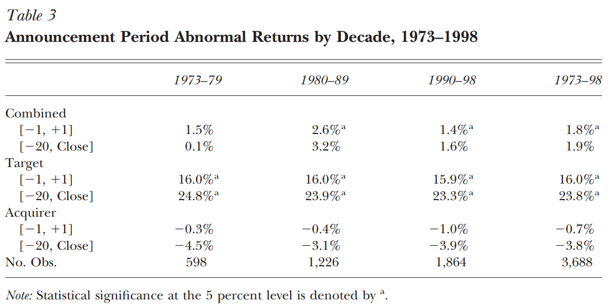
Stock Market Reaction to Merger Announcements
Notes:
The combined average abnormal returns are fairly similar across decades, ranging from 1.4 percent to 2.6 percent, and averaging 1.8 percent overall for 3,688 completed mergers.. And they are over this event window are reliably positive, suggesting that mergers do create shareholder value on average.
When the event window is expanded to begin 20 days prior to the merger announcement and end on the merger closing date, the combined average announcement period abnormal return is essentially identical at 1.9 percent.

Slide 8
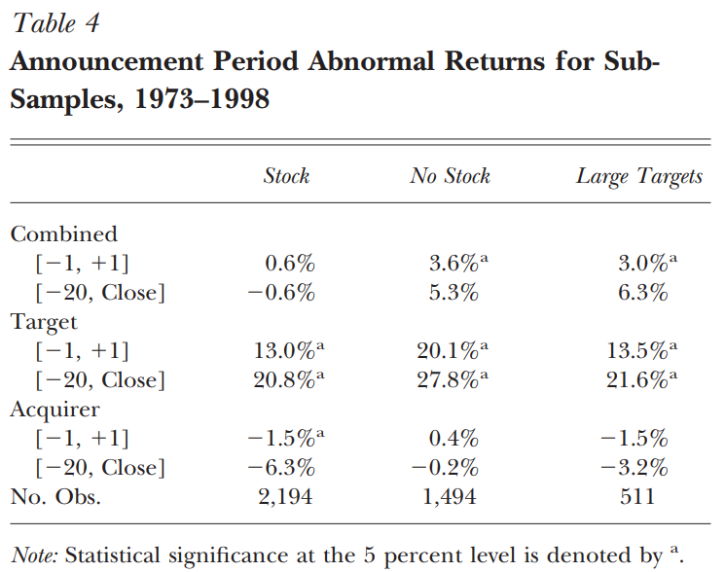
Stock Market Reaction to Merger Announcements
Notes:
Both acquiring firm and target firm do better when there is no equity financing
The combined average 3 day abnormal returns for stock-financed mergers are close to zero, suggesting that this subset of mergers do not increase overall shareholder value. On the other hand, the combined three-day abnormal returns for mergers financed without any stock are reliably positive at 3.6 percent.
*Overall, mergers create value on behalf of the shareholders of the combined firms

Slide 9
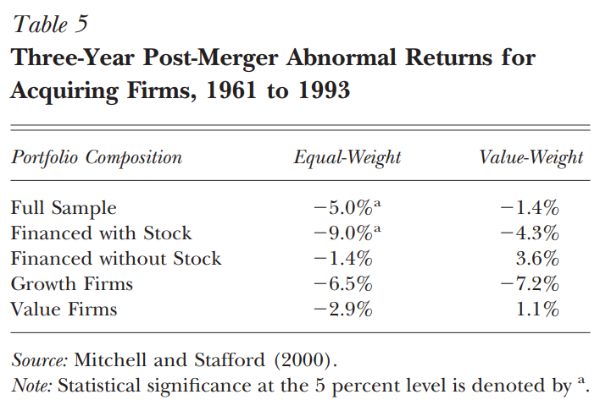
Long-Term Abnormal Returns
Notes:
Many previous literature shows big abnormal returns. For example, Loughran and Vijh (1997) find that acquiring firms using stock financing have abnormal returns of -24.2 percent over the five-year period after the merger, whereas the abnormal return is 18.5 percent for cash mergers. Using the value/growth distinction, Rau and Vermaelen (1998) calculate three-year abnormal returns of -17.3 percent for growth acquirers (book to market) and 7.6 percent for value acquirers over the period 1980-1991. The abnormal return estimates shown in Table 5 are considerably closer to zero than in most studies that use samples covering shorter time periods, and the dramatic differences in performance based on financing and the value/ growth distinction are greatly reduced.
Significant abnormal returns are only found for the equal-weight portfolios, suggesting that post-merger abnormal stock price performance is limited to the smallest acquirers.

Slide 10
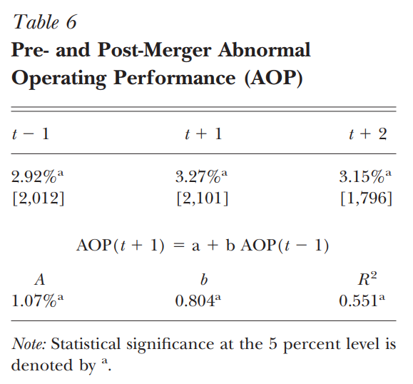
Pre- and Post-merger Profitability
Operating margin = cash flow to sales
Notes:
The first row: replicates the main findings of Healy, Palepu and Ruback (1992) that post-merger operating margins (cash flow to sales) are on average improved relative to industry benchmarks.
The second row: regress the post-merger abnormal operating performance measure on the pre-merger abnormal operating performance measure. On average, there is an improvement in operating margins following the merger, on the order of 1 percent, which is statistically significant at the 1 percent level.
The improvement in post-merger cash flow performance is consistent with the positive announcement-period stock market returns to the combined target and acquirer firms.

Slide 11
Conclusions
Prior literatures conclude that mergers create value for the stockholders of the combined firms, with the majority of the gains accruing to the stockholders of the target. The analysis of the immediate stock market response to more than 4,000 mergers completed during the 1973-1998 in this paper concurs with these prior reviews.
Prior literature conclude that the gains to shareholders must be real economic gains via the efficient rearrangement of resources. We are inclined to defend the traditional view that mergers improve efficiency and that the gains to shareholders at merger announcement accurately reflect improved expectations of future cash flow performance. But the conclusion must be defended from several recent challenges:
- A negative drift in acquiring firm stock prices is found following merger transactions, which would imply that the gains from mergers are overstated or nonexistent
- The underlying sources of the gains from mergers have not been identified
- All of the gains from mergers seem to accrue to the target firm shareholders. what should the abnormal returns for acquiring firms be?

Slide 12
Thank you!

